Slide 1
Computer Architecture
Prepared by Mohammed Sayeeduddin

Slide 2
Introduction to Hardware & OS
Global IT device spending Trend The Global information technology (IT) spending on devices, like pcs, tablets, mobile phones, printers, data center systems and software and communication services 4.24 in 2021 and 4.45 trillion USD in 2022
By 2024, IT spending is expected to increase to a staggering five trillion dollars worldwide. Reference:
https://www.statista.com/statistics/268938/global-it-spending-by-segment/

Slide 3
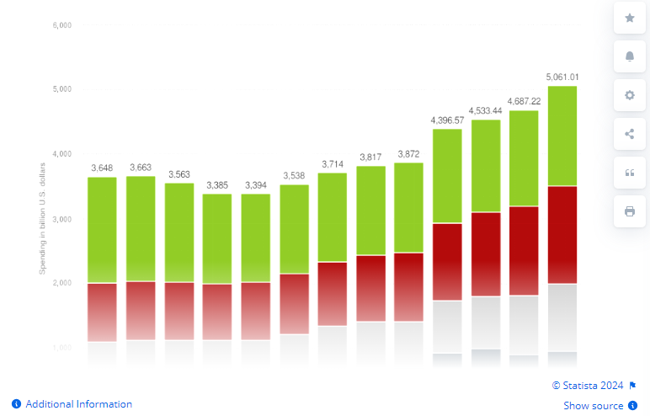
Graph

Slide 4

IT job outlook
667,600 posted opening with 13% growth through 2030 with median salary $112,161

Slide 5
What you will learn
Hardware and Computer Internals
Peripherals
Operating system Architecture
Software

Slide 6
How you will learn
Interactive Presentation and Q & A

Slide 7
Introduction to Computing Fundamentals
By end of this topic you will learn
1.What is computer I mean defining what is a computer is
2.Classification computer by size and usage
3.List the important function of computer
4.Benefit of Computer

Slide 8
What is a computer
A computer is a device or system that include
Hardware
OS
Application software
Peripheral

Slide 9
What is Hardware
Hardware refers to the physical components of a computer system, including the central processing unit (CPU), memory (RAM), storage devices (such as hard drives and SSDs), input/output devices (such as keyboards, mice, monitors, and printers), and other essential parts that make up the tangible aspects of the computer.

Slide 10
What is OS
An operating system (OS) is software that manages a computer's hardware resources and provides common services for computer programs. It acts as an intermediary between the hardware and the software applications running on the computer. The operating system facilitates tasks such as managing memory, controlling input and output devices, handling file systems, and providing a user interface. Popular examples of operating systems include Microsoft Windows, macOS, Linux, and Unix.

Slide 11
What is application Software
Application software refers to programs designed to perform specific tasks or functions for end users. Unlike system software (like operating systems), which manage the computer's hardware and provide foundational services, application software is tailored to meet the needs of users in various domains, such as word processing, spreadsheet management, web browsing, gaming, and multimedia editing. Examples include Microsoft Word, Excel, web browsers like Google Chrome, video editing software like Adobe Premiere Pro, and games like Minecraft.

Slide 12
What is peripherals
Peripherals are external devices connected to a computer that expand its functionality and allow users to interact with the system. Examples include input devices like keyboards and mice, output devices like monitors and printers, storage devices like external hard drives, and networking equipment like modems and routers. Peripherals enhance the capabilities of the computer by enabling input, output, storage, and communication.

Slide 13
Classification of Computer size and usage
Computers can be classified based on their size and usage into several categories:
1. Supercomputers: These are the most powerful computers, used for intensive numerical calculations and simulations in scientific research, weather forecasting, and engineering design.
2. Mainframe Computers: Mainframes are large, high-performance computers used by large organizations for handling massive amounts of data and running critical business applications such as banking transactions, airline reservations, and enterprise resource planning (ERP) systems.
3. Minicomputers: Minicomputers are smaller than mainframes but larger than microcomputers. They are used for mid-sized businesses, scientific computations, and as network servers.
4. Microcomputers: Also known as personal computers (PCs), microcomputers are small, affordable computers designed for individual use. They include desktops, laptops, tablets, and smartphones and are used for a wide range of tasks, including office work, internet browsing, gaming, and multimedia entertainment.

Slide 14
Continue..
5. Workstations: Workstations are high-performance computers optimized for technical or scientific applications such as computer-aided design (CAD), graphic design, and multimedia editing.
6. Embedded Computers: These are specialized computers built into other devices and systems, such as household appliances, automobiles, industrial machinery, and medical devices. They are designed to perform specific functions and are often smaller and less powerful than general-purpose computers.
Each category serves different purposes and is tailored to meet specific computing needs.

Slide 15
Use by classificaiton
General Computer
Special purpose like IOTS

Slide 16
General Computers
General-Purpose Computers:
Description: General-purpose computers are versatile devices designed to perform a wide range of tasks and applications.
Usage: Used for everyday computing needs such as office work, internet browsing, multimedia entertainment, gaming, programming, and personal productivity. Examples include personal computers (PCs), laptops, tablets, and smartphones.

Slide 17
Special Computers
Description: Special-purpose computers are designed for specific applications or tasks, often with optimized hardware and software configurations.
Usage: Tailored to meet the requirements of particular industries or applications, they excel in performing specialized functions efficiently. Examples include:
IoT (Internet of Things) Devices: Small, embedded computers integrated into everyday objects to collect, process, and transmit data for monitoring, automation, and control purposes.
Point-of-Sale (POS) Systems: Computers used in retail environments to process transactions, manage inventory, and track sales data.
Industrial Control Systems: Computers used in manufacturing and industrial settings to control machinery, monitor processes, and automate production tasks.
Automotive Computers: Computers embedded in vehicles for managing engine

Slide 18
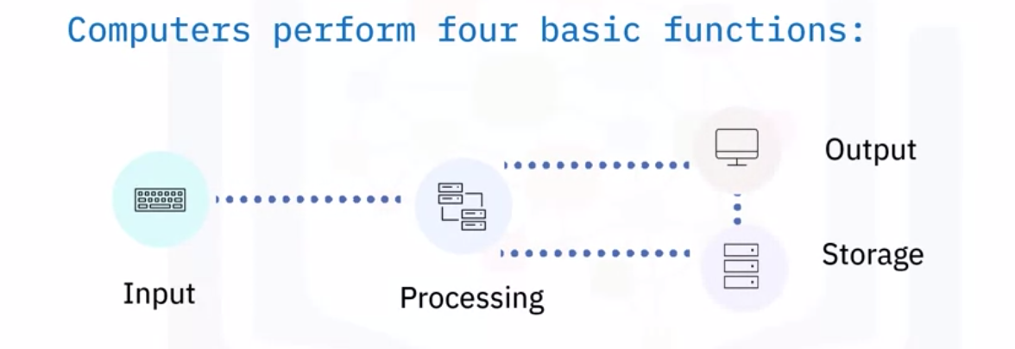
Basic function of a computer
1. Input 2. Process 3.Output 4.Storage

Slide 19
What is input
Input refers to the act of providing data or commands to a computer system, typically through various means such as typing on a keyboard, speaking voice commands, or clicking buttons using a mouse or other input device. 1.Typing
2.Using voice command
3.Click buttons

Slide 20
What is processing
Processing involves the manipulation and interpretation of the input data by the computer's central processing unit (CPU) and other components. This includes executing instructions, performing calculations, making decisions based on predefined algorithms, and generating output.
In essence, processing transforms the raw input data into meaningful information or results according to the desired computational tasks.

Slide 21
what is output
Output represents the outcome of the computational process, conveying the processed information to users or other systems for further use or interpretation.

Slide 22
What is storage
Storage refers to the capability of a computer system to retain data, programs, and information for future use. It involves saving data in a persistent form, typically on physical or virtual storage devices such as hard disk drives (HDDs), solid-state drives (SSDs), optical discs, magnetic tapes, or cloud-based storage services. Storage allows computers to store and retrieve data as needed, enabling users to preserve information, install software, and maintain the system's state across sessions.

Slide 23
Benefits of computers
1. Increased Efficiency: Computers automate tasks, streamline processes, and enable multitasking, leading to enhanced productivity and faster execution of tasks.
2. Access to Information: Computers provide access to vast amounts of information through the internet, databases, and digital libraries, facilitating research, learning, and decision-making.
3. Communication: Computers enable communication through email, instant messaging, video conferencing, and social media, connecting people globally and facilitating collaboration.
4. Data Processing and Analysis: Computers can process large volumes of data quickly and accurately, enabling data analysis, modeling, and forecasting in various fields such as science, business, and healthcare.

Slide 24
Continue..
5. Creative Expression: Computers empower users to create digital content, including artwork, music, videos, and writing, fostering creativity and self-expression.
6. Entertainment: Computers offer a wide range of entertainment options, including gaming, streaming media, online content, and virtual experiences, providing relaxation and enjoyment.
7. Automation and Control: Computers control and automate various systems and processes in industries such as manufacturing, transportation, and healthcare, improving efficiency, safety, and reliability.
Overall, computers play a crucial role in modern society, enhancing productivity, communication, creativity, and entertainment while enabling innovation and progress in various fields.

Slide 25
Type of computing devices
Computing devices and platforms encompass a variety of technologies, including:
1. Personal Computers (PCs): General-purpose computers designed for individual use, including desktops, laptops, and tablets.
2. Mobile Devices: Portable computing devices such as smartphones and tablets, running operating systems like iOS and Android.
3. Workstations: High-performance computers optimized for technical or scientific tasks, such as CAD and graphic design.
4. Servers: Computers designed to provide services or resources to other computers on a network, used for hosting websites, managing databases, and more.

Slide 26
Continue..
5. Embedded Systems: Specialized computers integrated into other devices and systems, such as IoT devices, automotive systems, and medical devices.
6. Cloud Computing Platforms: Infrastructure and services provided over the internet, allowing users to access computing resources and applications remotely.
Each type of computing device and platform serves different purposes and caters to specific computing needs, contributing to the diverse landscape of modern technology.

Slide 27
Notational System
Computer notation systems are fundamental to how computers represent and process data. The most common notation system used in computing is the binary system, which employs only two symbols, typically denoted as 0 and 1. In binary notation, each digit is referred to as a bit (short for binary digit).
Binary Notation (Base-2)
Decimal Notation (Base-10)
Hexadecimal Notation (Base-16)

Slide 28
Operating System
Introduction to Operating System

Slide 29
We will discuss in this session
Describing the Operating system
classification
OS generation
History

Slide 30
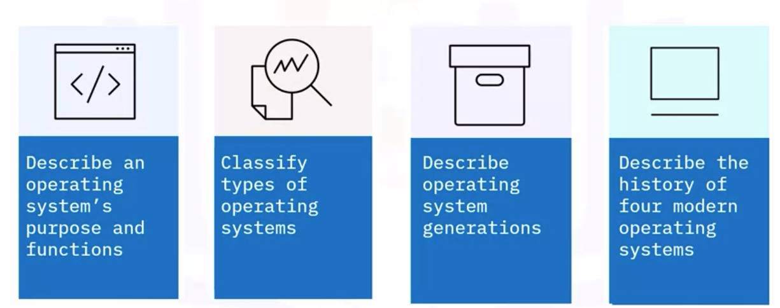

Slide 31
What is Operating System
Operating systems (OS) are the core software that manages computer hardware and provides services for applications. They serve as an intermediary between the user and the computer hardware, facilitating communication and resource management

Slide 32
Types of Environment
Operating systems (OS) environments can be broadly categorized into several types based on their intended use, architecture, and user interface.
Here's a brief overview of user interface based
1.Commandline interface
2.Graphical User interface (GUI)

Slide 33
Operating System History
4 generation
1.1945 to 1955
2.1955 to 1965
3.1965 to 1980
4.1980 to 1995
5.1995 to now

Slide 34
First single-steam OS
General Motor research developed first single-stream operating
system in 1956 for IBM 704 Computer system
IBM became IBM was one of the pioneering companies for releasing OS

Slide 35
Modern OS
Windows
Unix
Linux
Mac OS

Slide 36
Computer Components
Internal
External

Slide 37
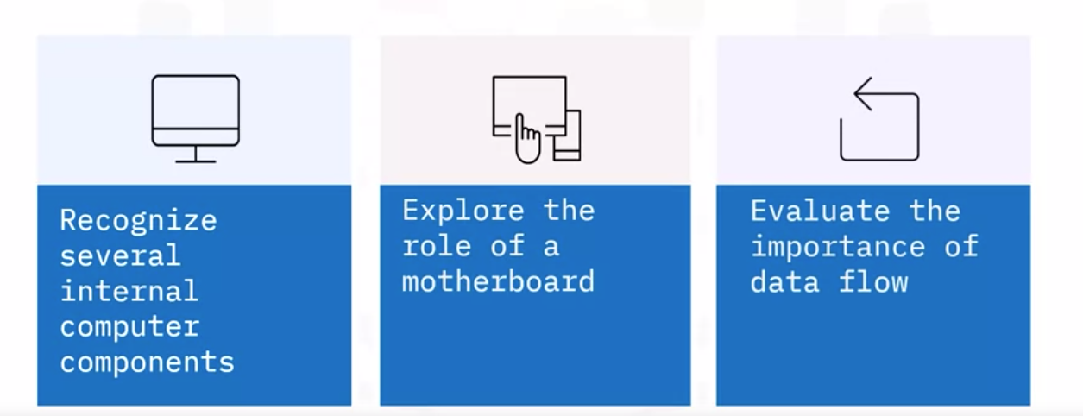
Computer Internal Components

Slide 38
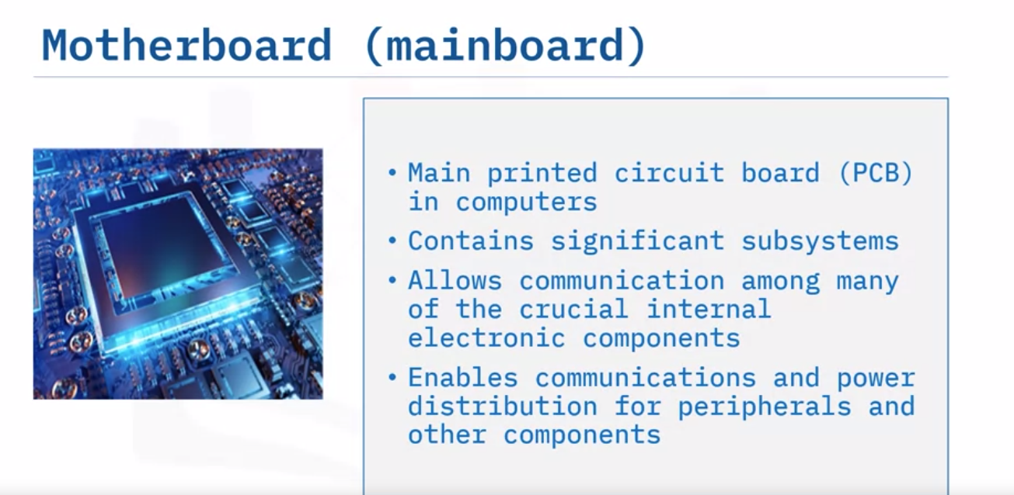
What is mother board

Slide 39
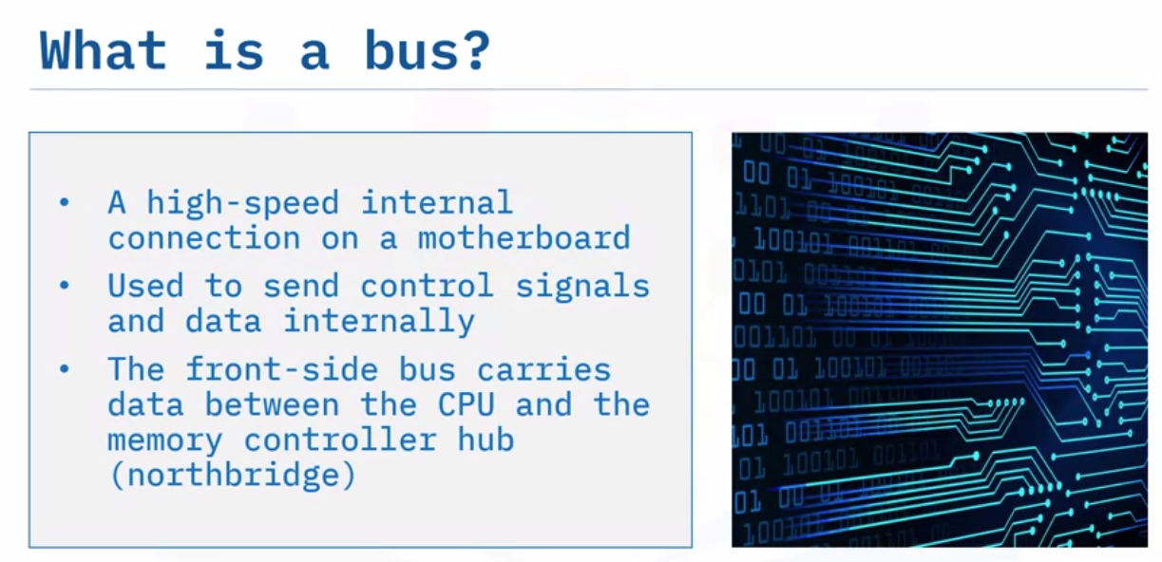

Slide 40
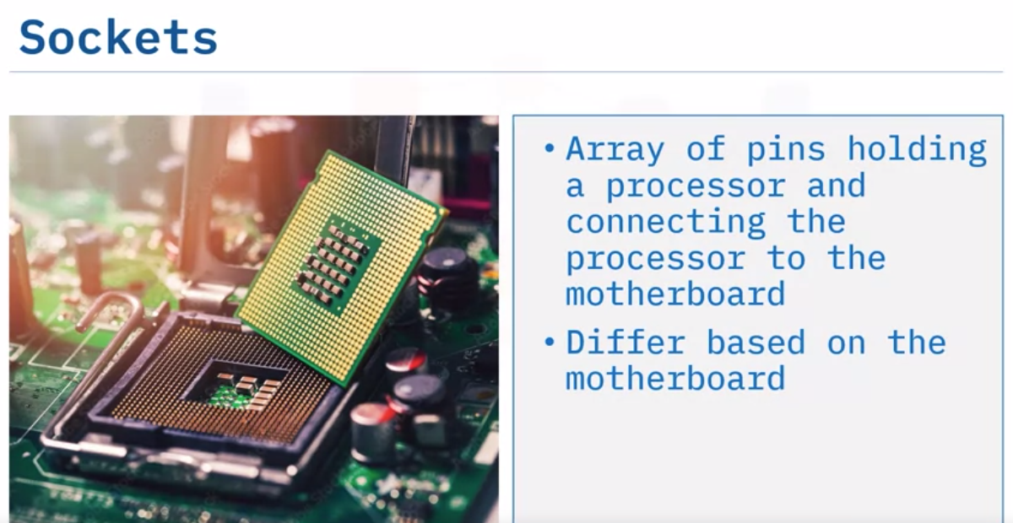
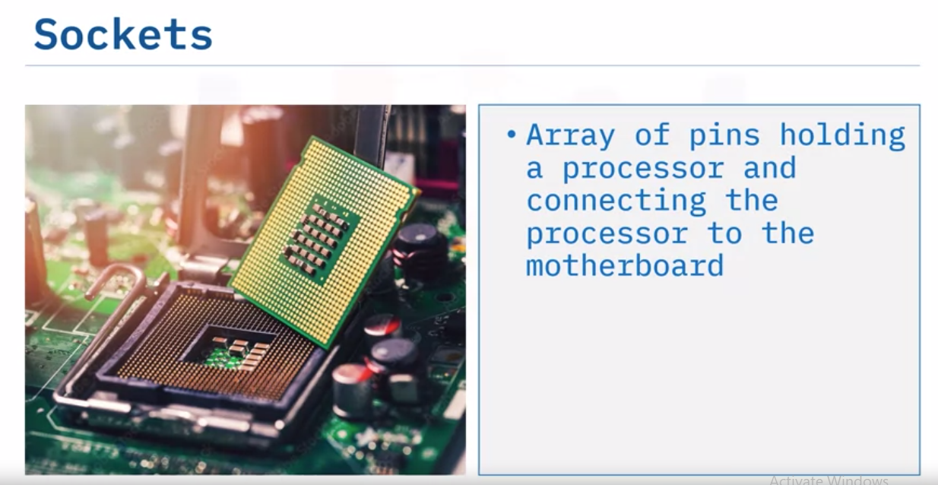

Slide 41
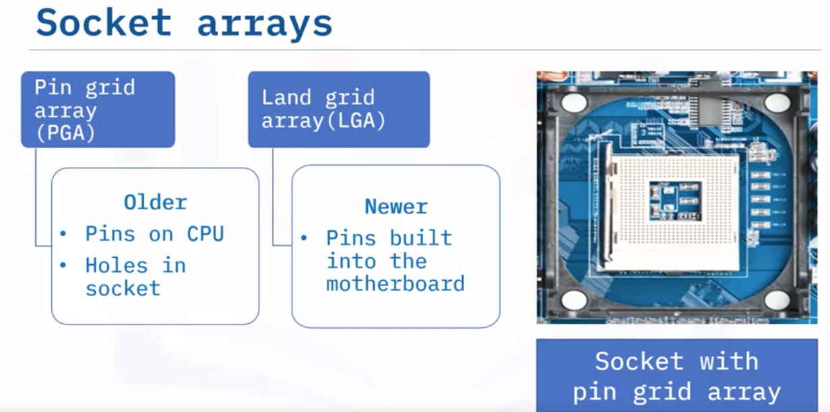

Slide 42
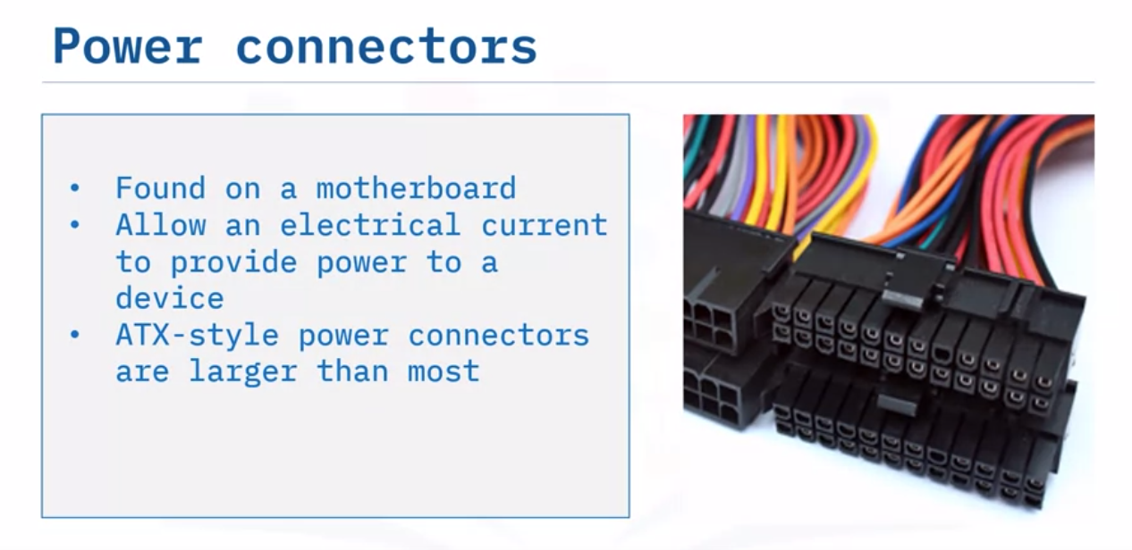

Slide 43
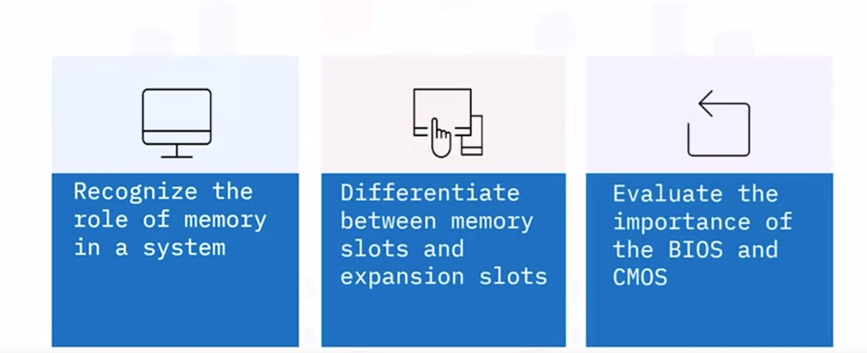
Data Processing and Storage

Slide 44
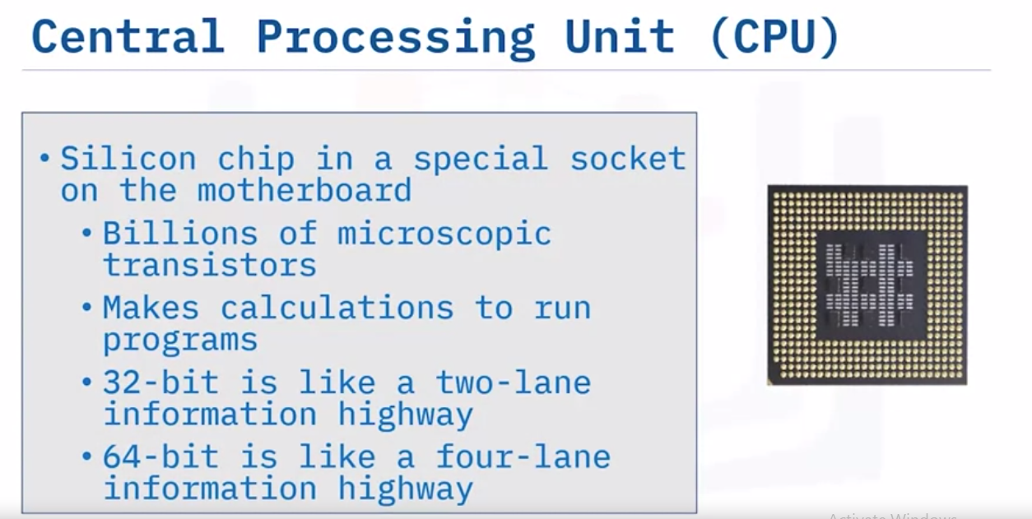
Data processing

Slide 45
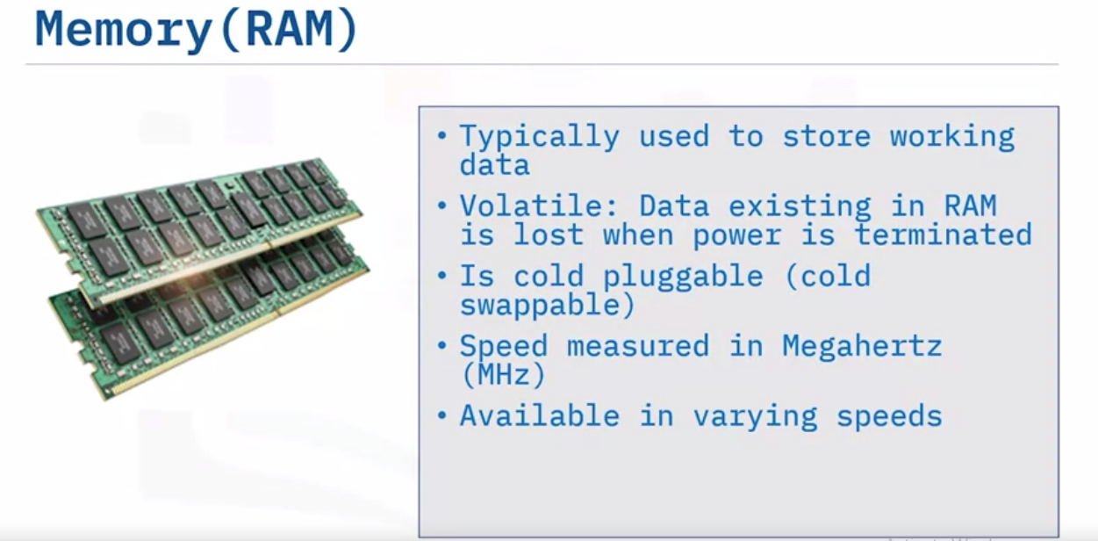

Slide 46
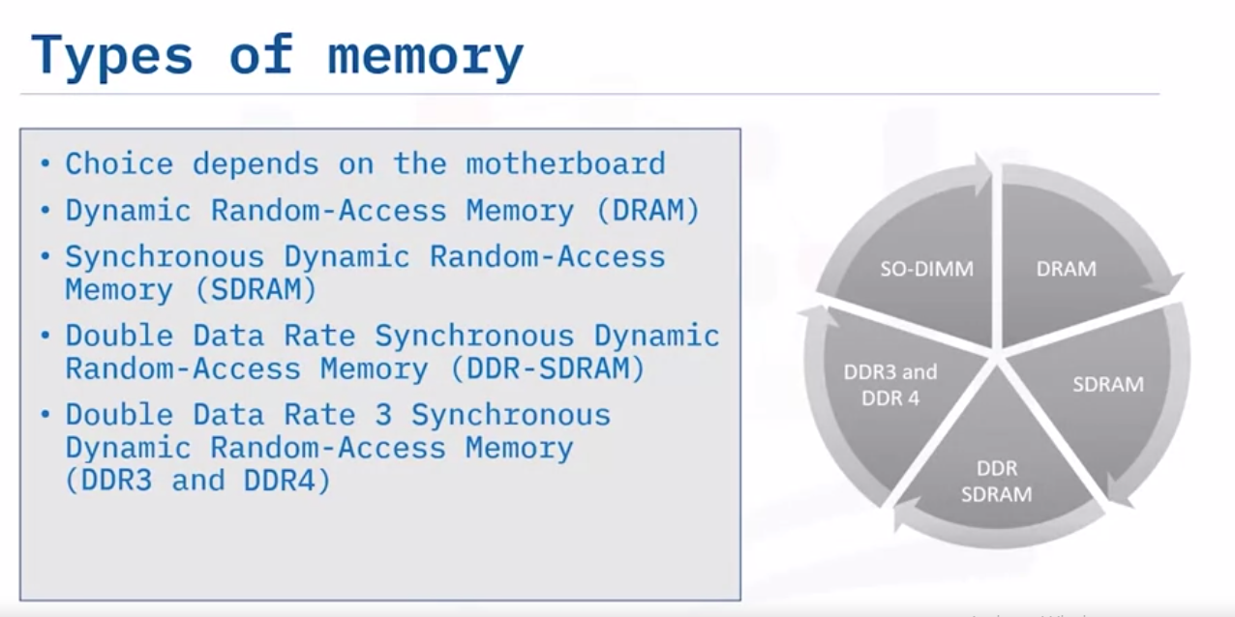

Slide 47
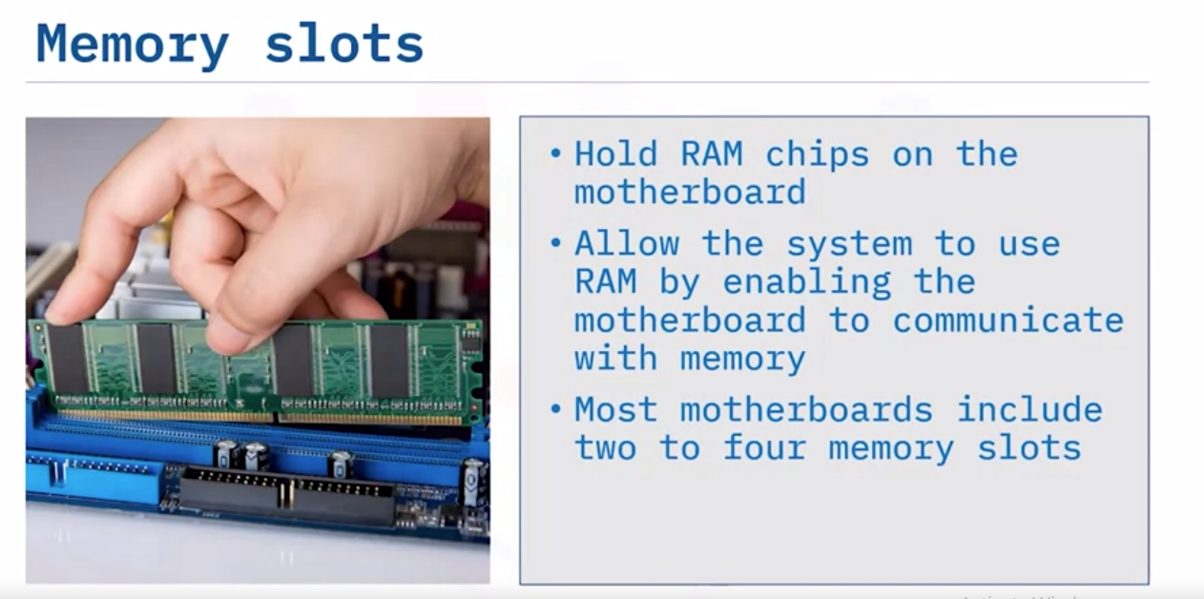

Slide 48
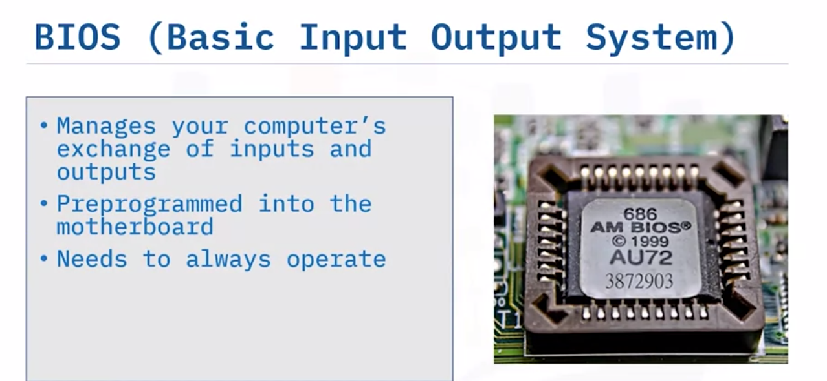

Slide 49
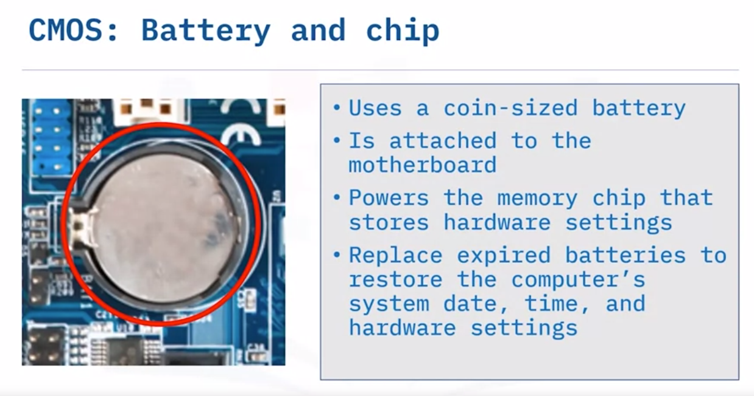

Slide 50
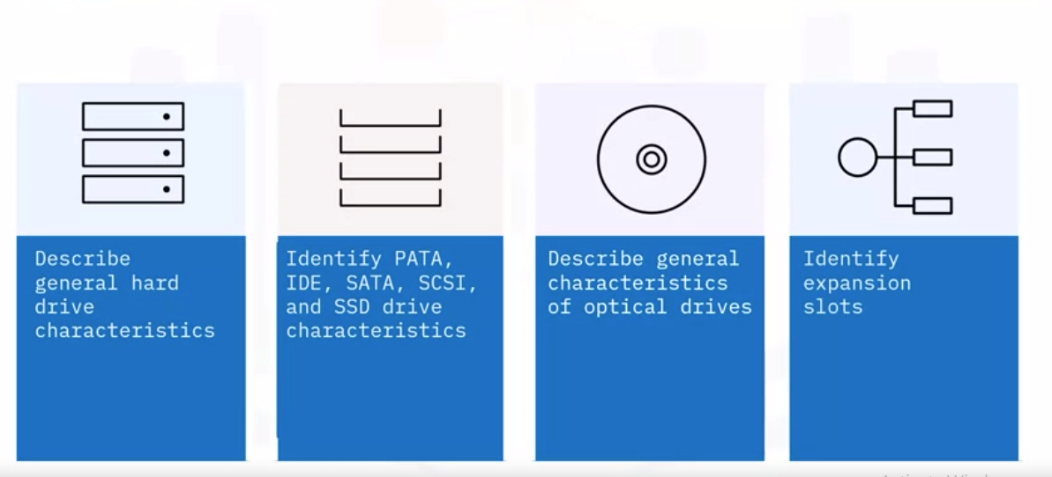
Internal Storage

Slide 51
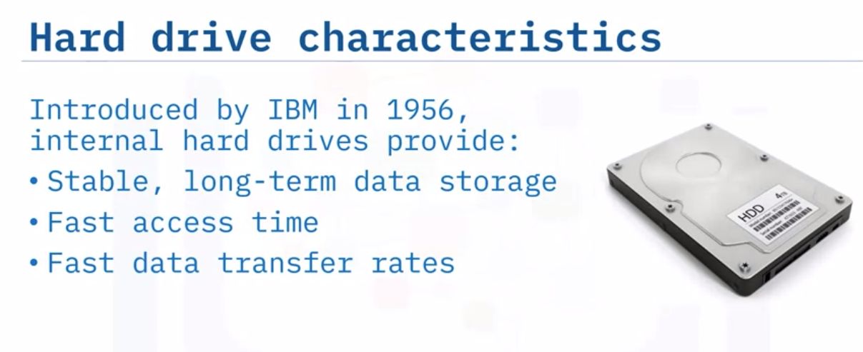

Slide 52
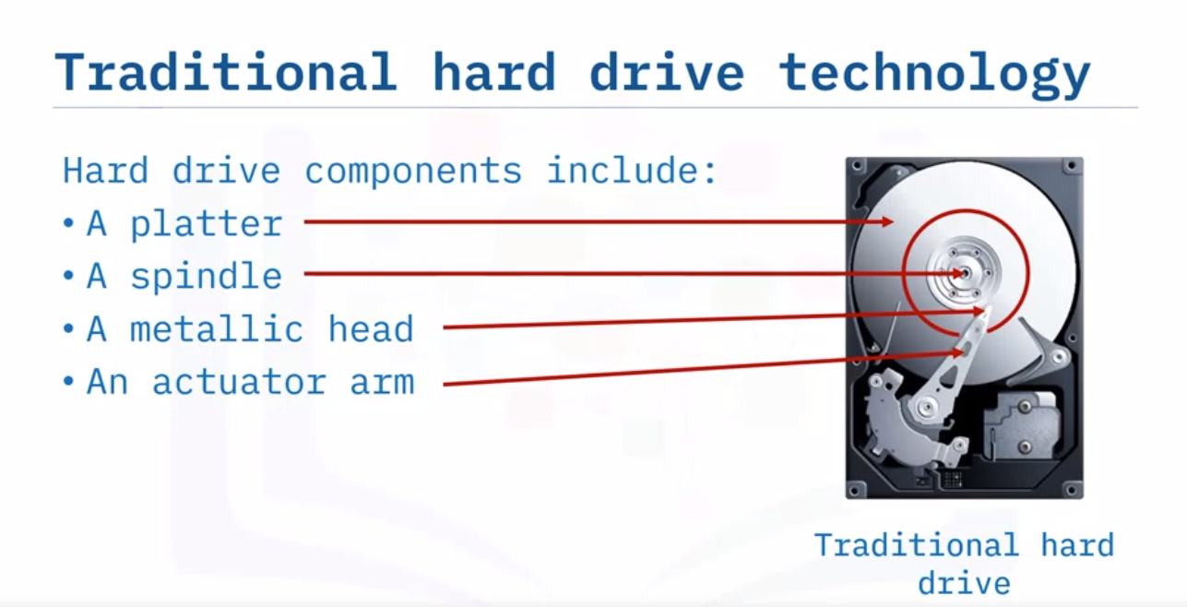

Slide 53
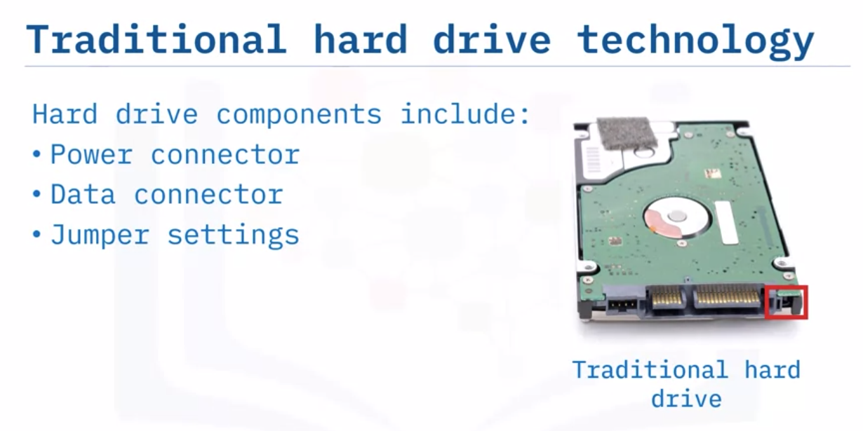

Slide 54
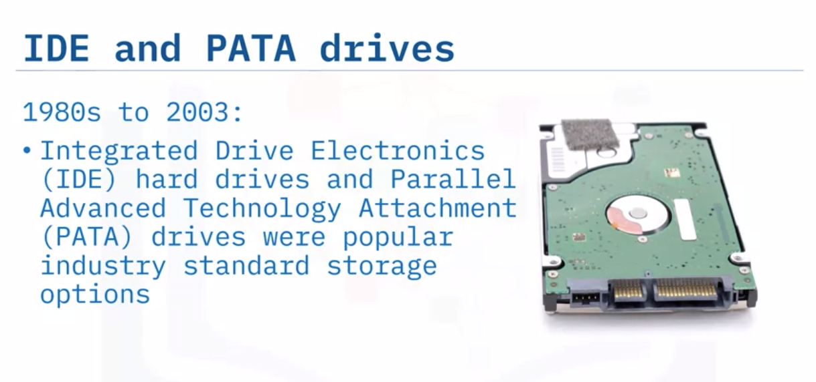

Slide 55
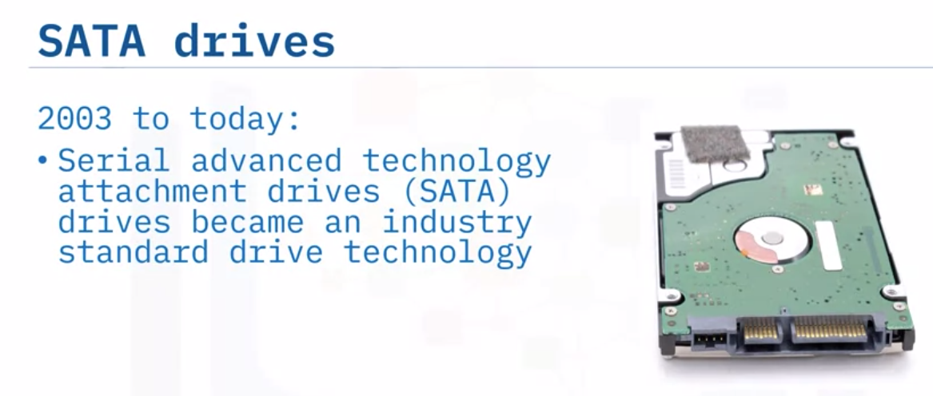

Slide 56
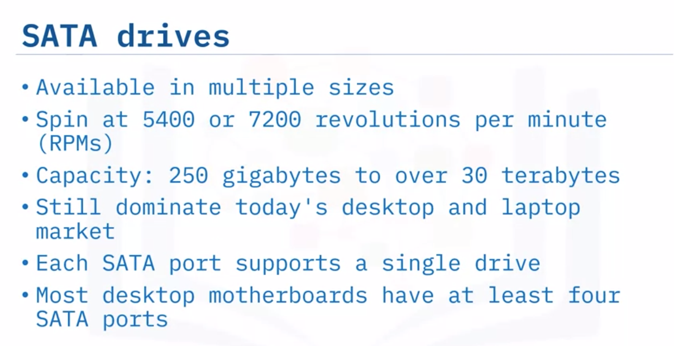

Slide 57
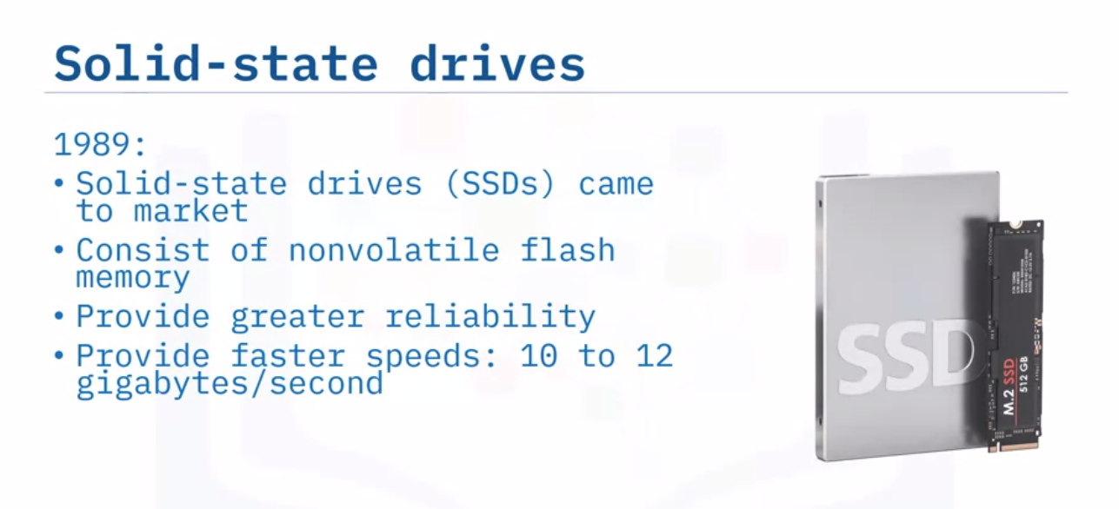
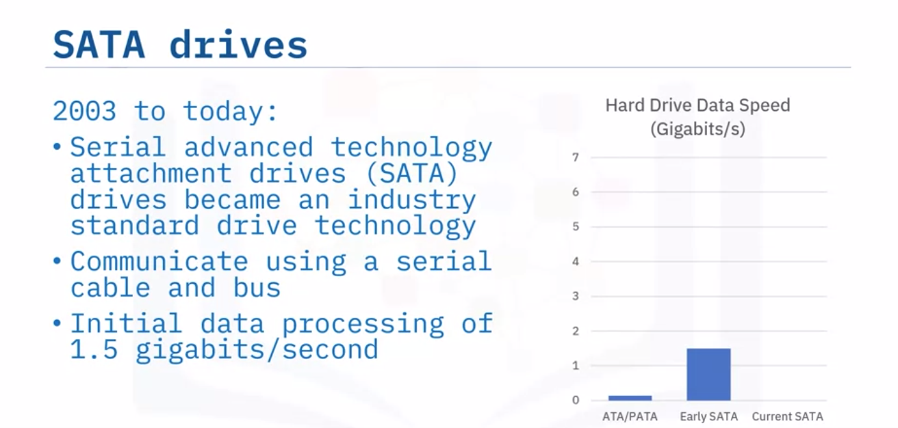

Slide 58
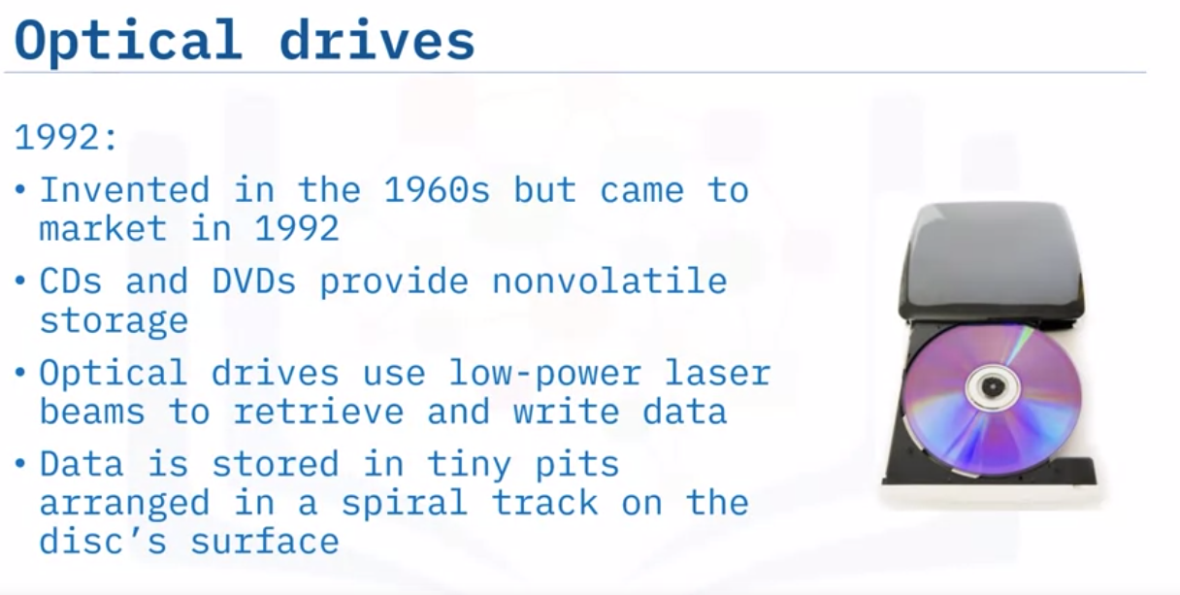

Slide 59
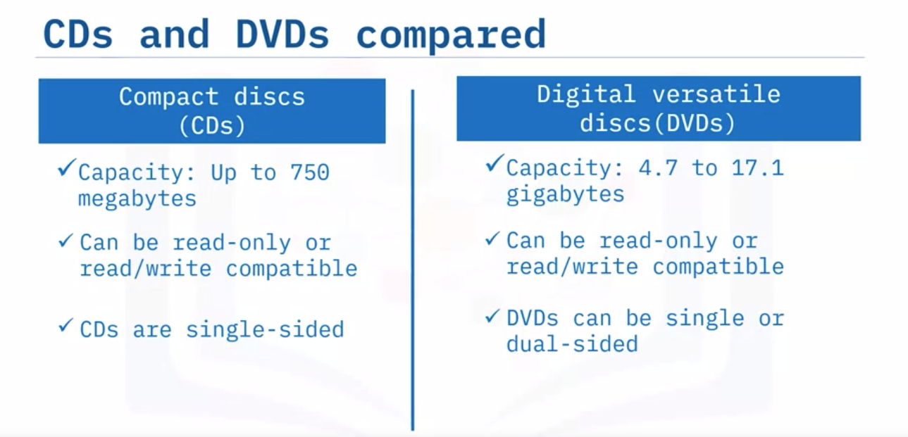

Slide 60
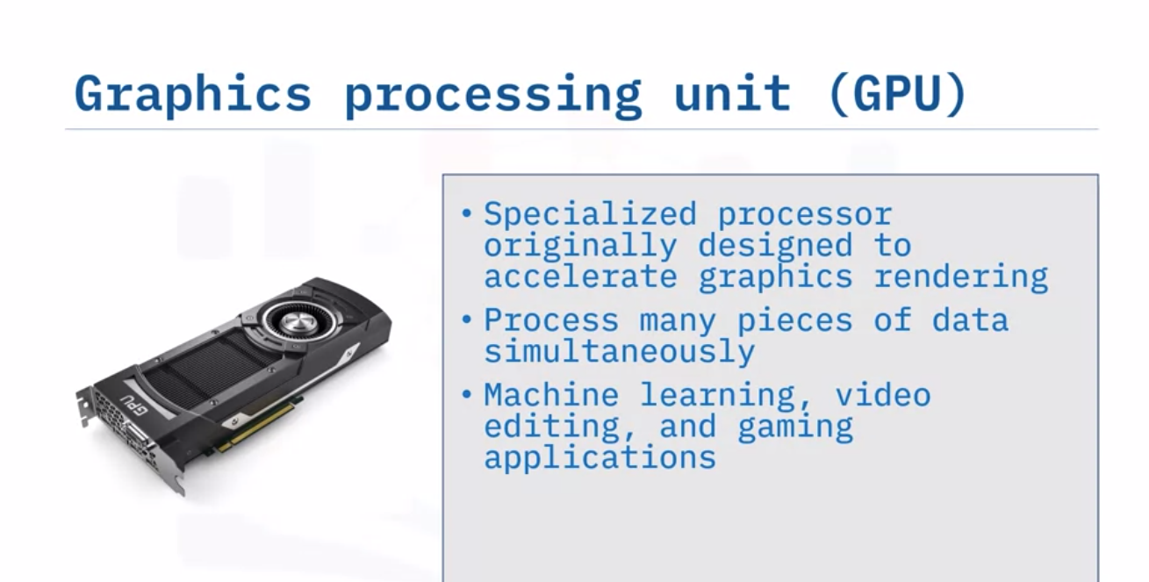
Graphic Card and GPU

Slide 61
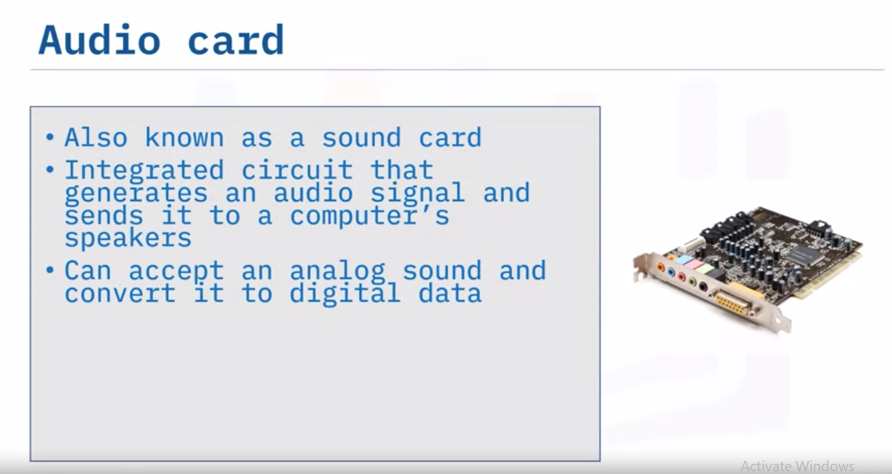

Slide 62
Quiz
Multiple Choice Questions

Slide 63
Quiz. 01
Select the category of computers that includes personal computers, laptops, smartphones, and other single-user devices.
Supercomputers
Mainframe computers
Minicomputers
Microcomputers

Slide 64
Quiz. 02
Computers can use a variety of notational systems and data types. Select the answer that identifies which computer data type displays text, including emoticons, to computer users.
Bits and bytes
Unicode
ASCII
Hexadecimal

Slide 65
Quiz. 03
interact with a network. __________________ are generally installed on networks enabling shared access to data, files, and media such as movies, videos, and sound clips.
Mobile devices
Servers
Internet of Things (IoT) devices
Workstations

Slide 66
Quiz. 04
Operating systems date back to the early 1900s, with several companies credited for their contributions. Select the option with the answers that correctly fill in the blanks. In _____, _______ created the first single-stream batch file operating system.
1985, Microsoft Windows
1991, Linux Torvalds
2013, Google
1956, GM Research

Slide 67
Quiz. 05
Select the option that matches the four methods you can use to sign in to a Microsoft Windows computer.
Fingerprint, PIN, Photo, Bluetooth
Voice, Password, PIN, and Fingerprint
PIN, Password, Bluetooth, and Voice
PIN, Password, Photo, and Fingerprint

Slide 68
Answer is:
Microcomputers include personal computers, laptops, smartphones, and other single-user devices.
Unicode, specifically UTF-8, is widely used for web pages and displays formatted characters, including emoticons.
Servers are generally installed as standalone units on networks and function as repositories for file and data storage, movies, videos, and sound clips, or holds documents in queues for print jobs.
GM Research is credited for creating the first single-stream batch file operating system for their IBM 704 mainframe in 1956.
You can use a PIN, Password, photo, or a fingerprint to sign in to a Microsoft Windows computer.

Slide 69
Networking Concepts

Slide 70
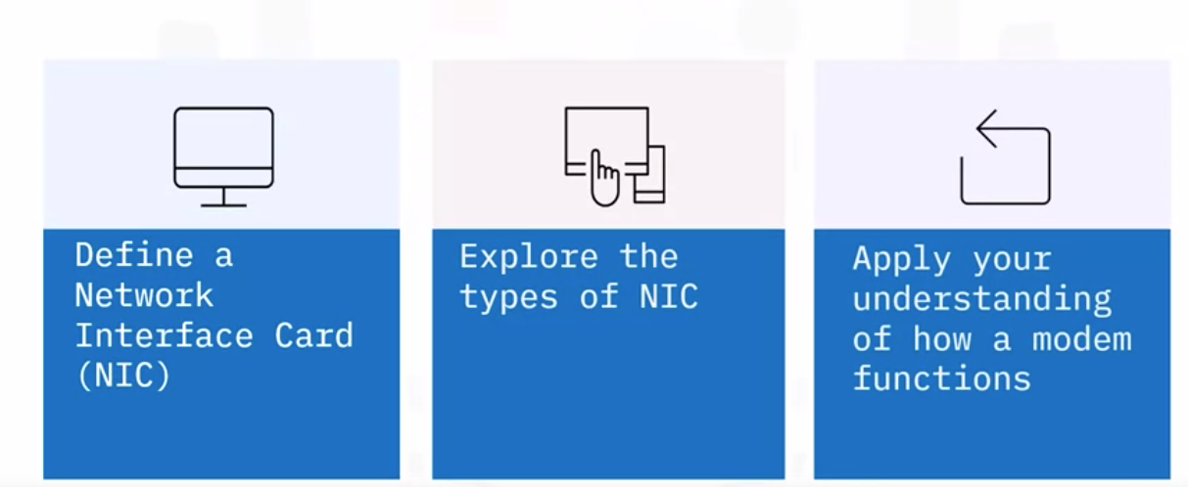
Networking concept

Slide 71
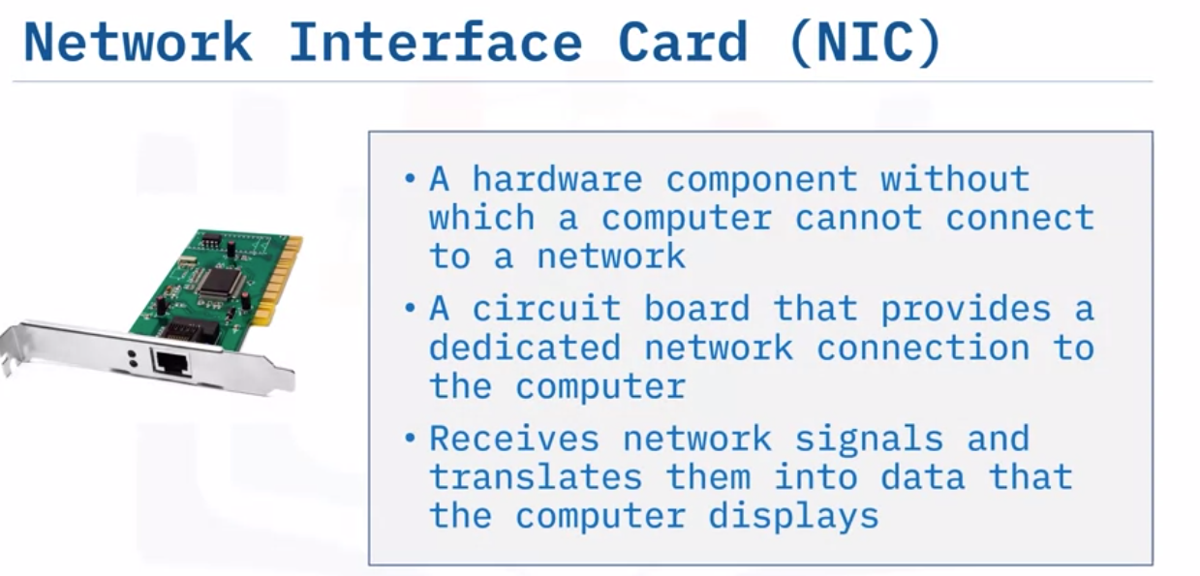

Slide 72
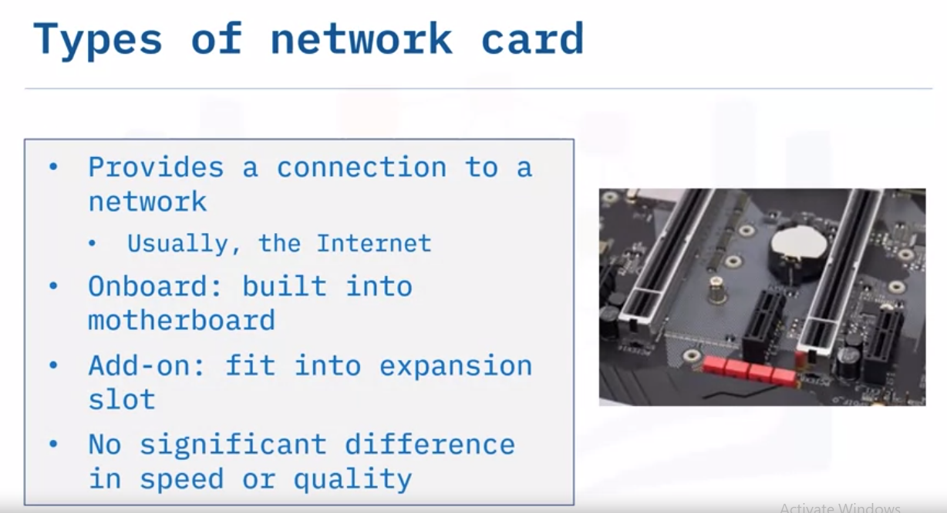

Slide 73
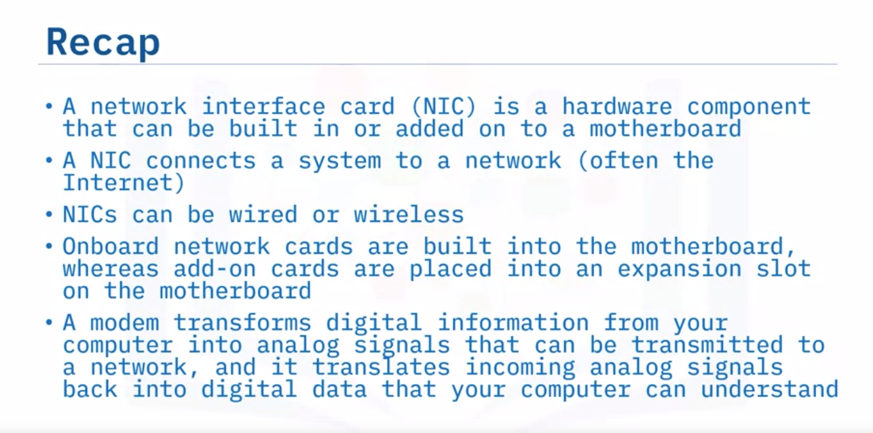

Slide 74
Protocols

Slide 75
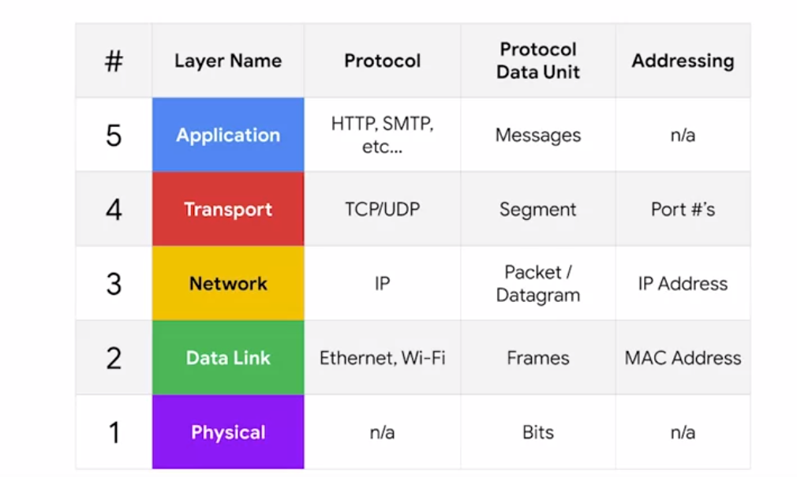
Graph

